Slide 1
Predictive Analytics Hackathon
Ben Carter,
Emma Watmore,
Jamal Fazaldin

Slide 2
Predicting mortgage application outcomes
Situation
Proton Bank is looking to automate their loan application process due to a surge in the number of applicants.
Task
We are building a logistic regression model to predict whether a loan application will be rejected or approved by identifying key risk factors.
Action
1. Review and clean data and perform EDA.
2. Identify influential factors.
3. Build and evaluate a logistical regression model.
5. Analyse feature importance to understand drivers of loan rejection.
Result
The most influential factors leading to loan decisions will be identified, helping Proton Bank focus on high-quality applications and improve operational efficiency.

Slide 3
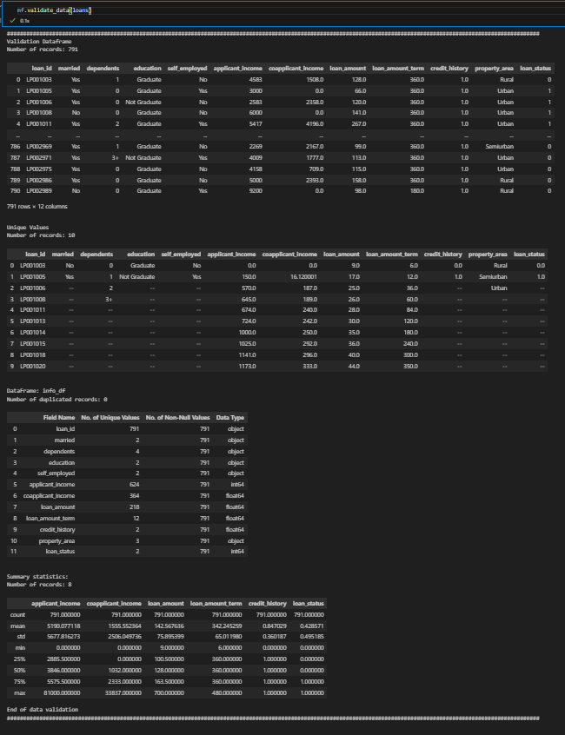
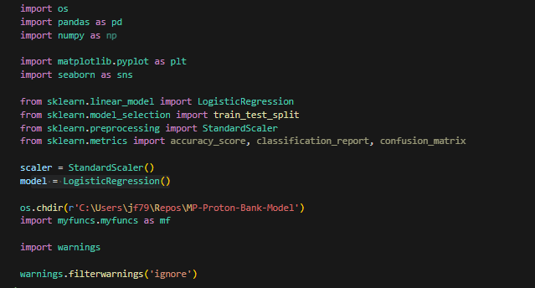
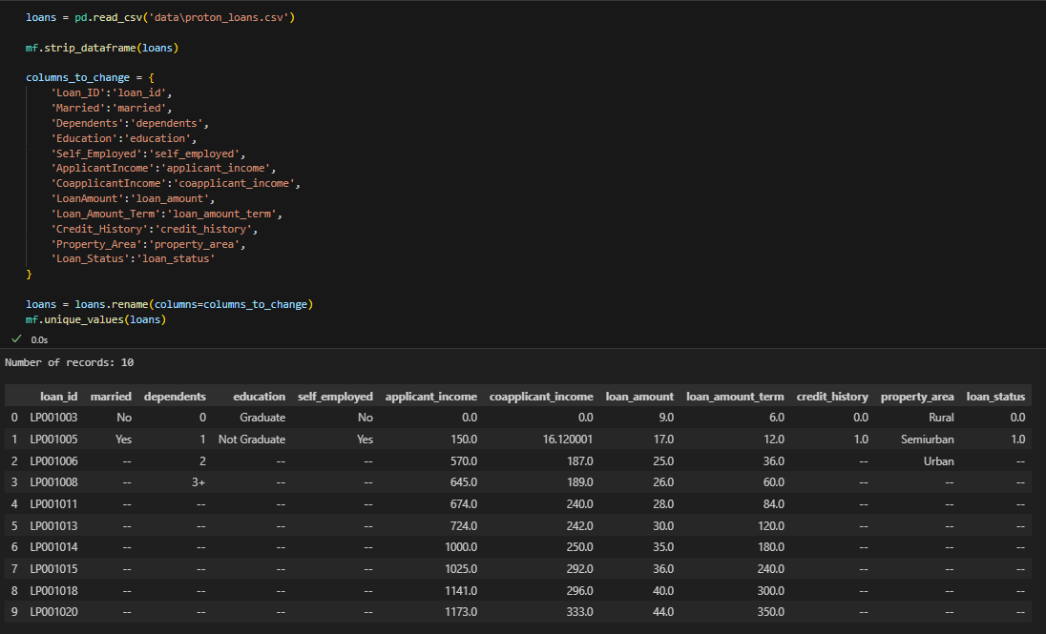
Data Cleaning
Renaming fields and outputting using a custom function to validate the data by outputting unique values, outputting the number of unique values, non-null values and data types for each field, the number of duplicate records and a summary of the datasets numerical fields.
Imported Libraries
Reading the data and stripping whitespace from all values using a custom function

Slide 4
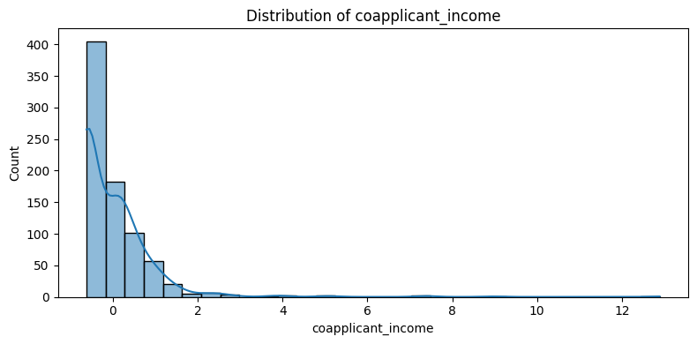
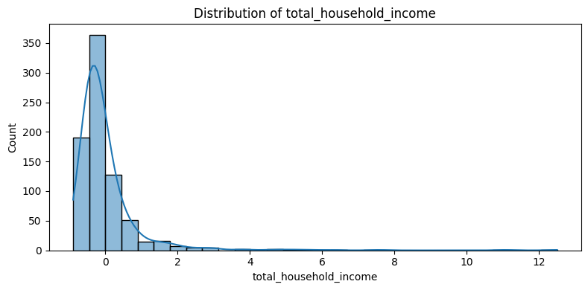
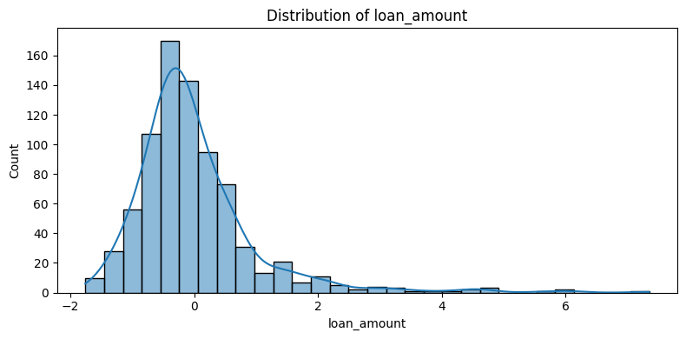
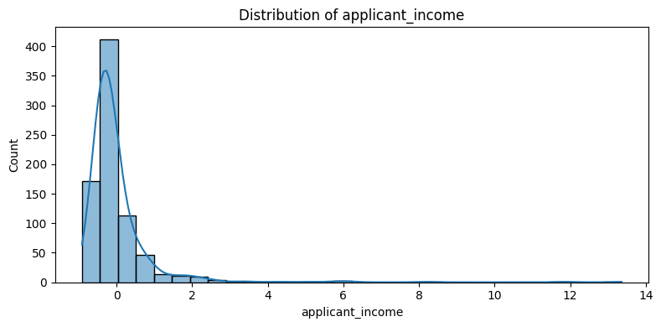
Data Cleaning
Ensuring that there is a normal distribution across our continuous variables.

Slide 5

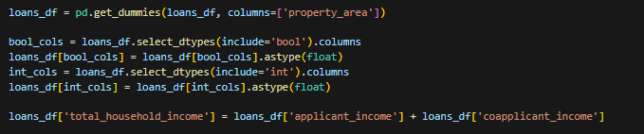
Data Cleaning
Converting Boolean-Like Categories to Binaries.
Cleaning and changing the data type of the dependents field to Float points.
Transposing the “property_area” field via one-hot encoding to enhance model performance.
Ensuring all numerical fields (incl. Booleans) are represented as float points. In addition, feature engineered total household income to enhance model performance.

Slide 6
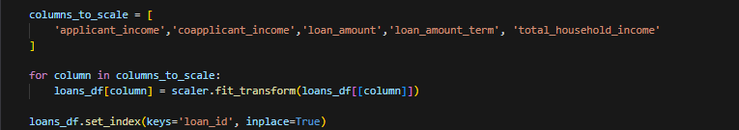
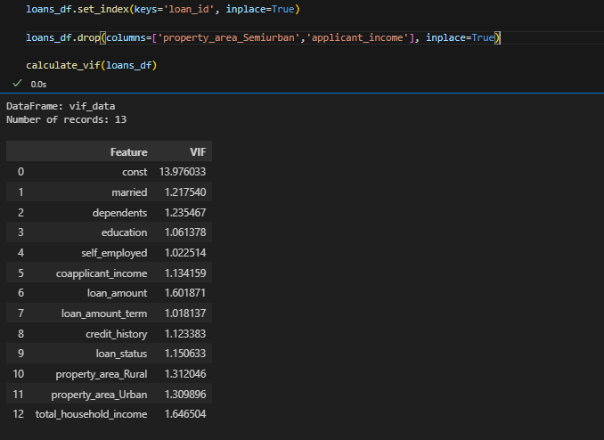
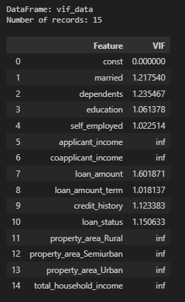
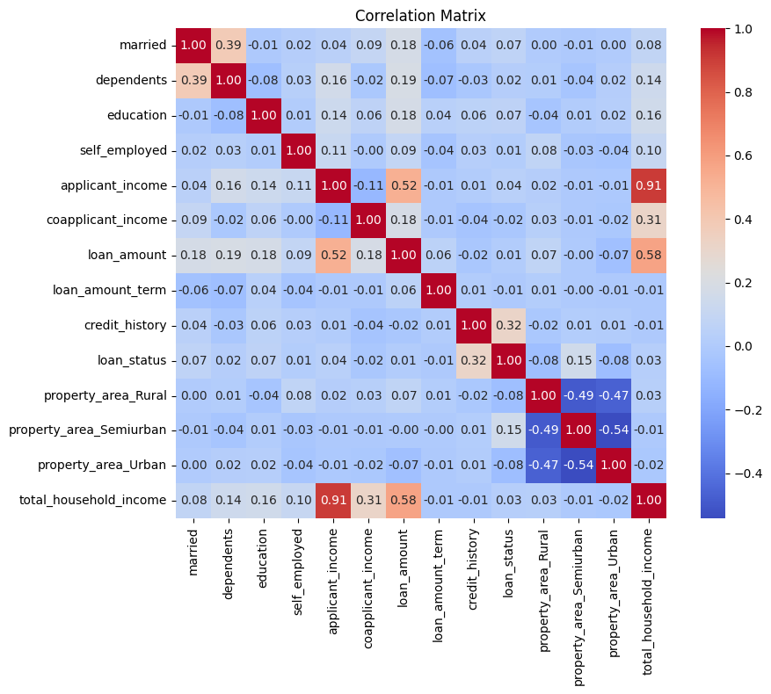
Data Cleaning
Normalised all relevant non-binary numerical fields to enhance model performance using Standard Scler as part of the sci-kit learn package
Using VIF and a correlation matrix to understand where multicollinearity is occurring, how severely and informing the best way to address it.
Before
After

Slide 7
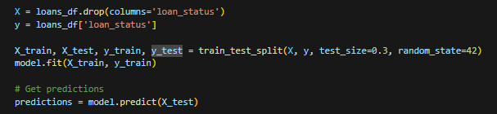
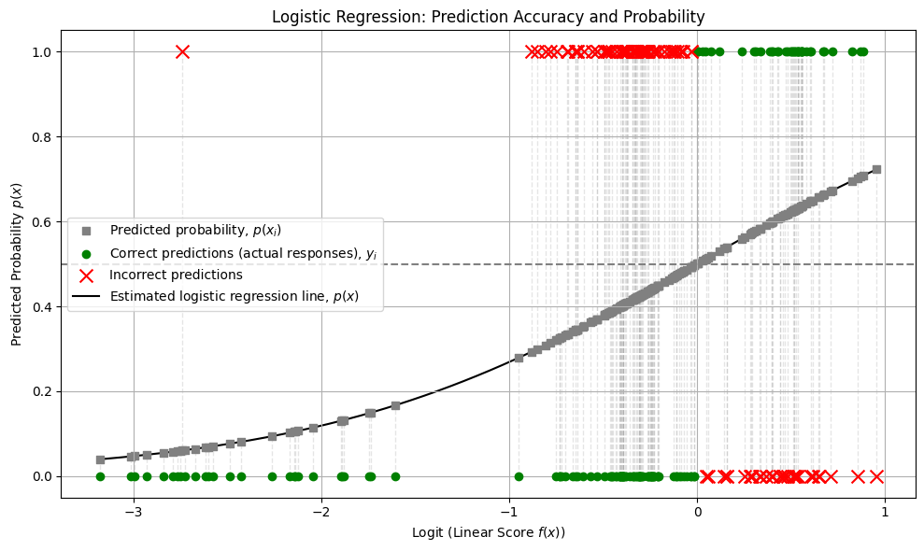
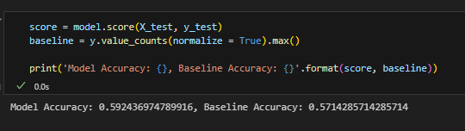
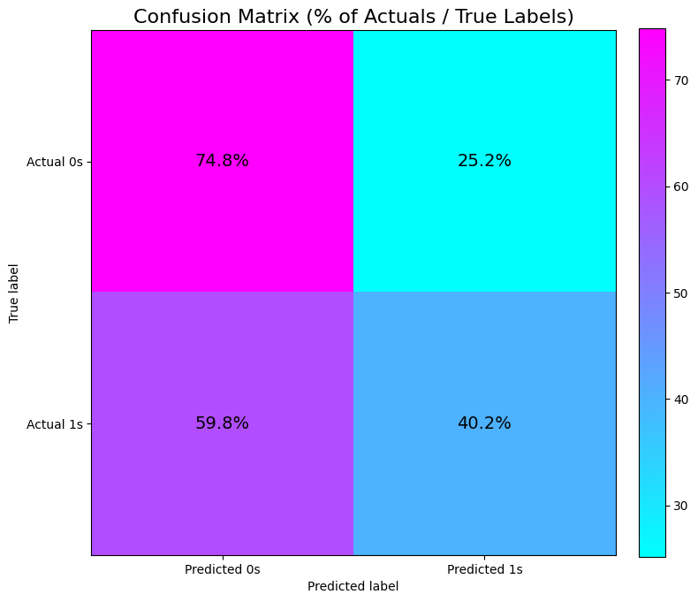
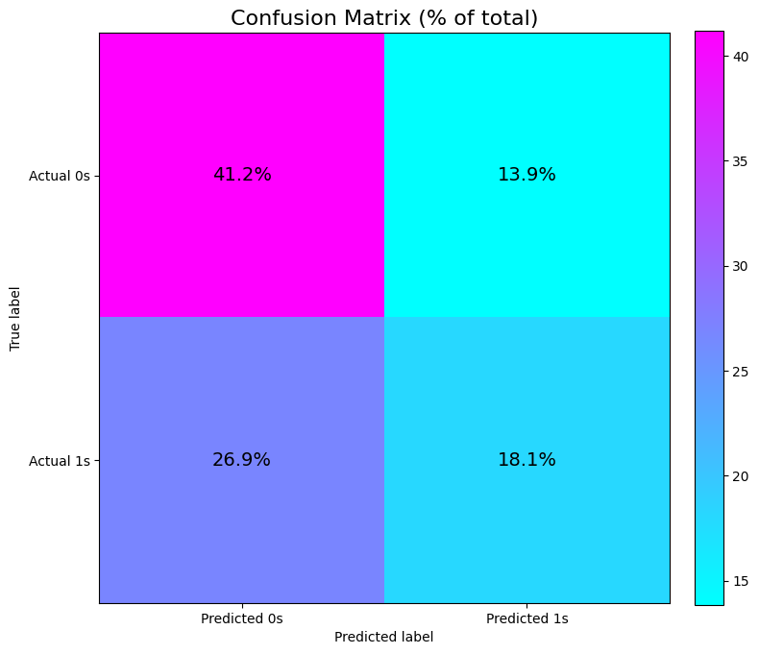
Model fitting and Evaluation

Slide 8
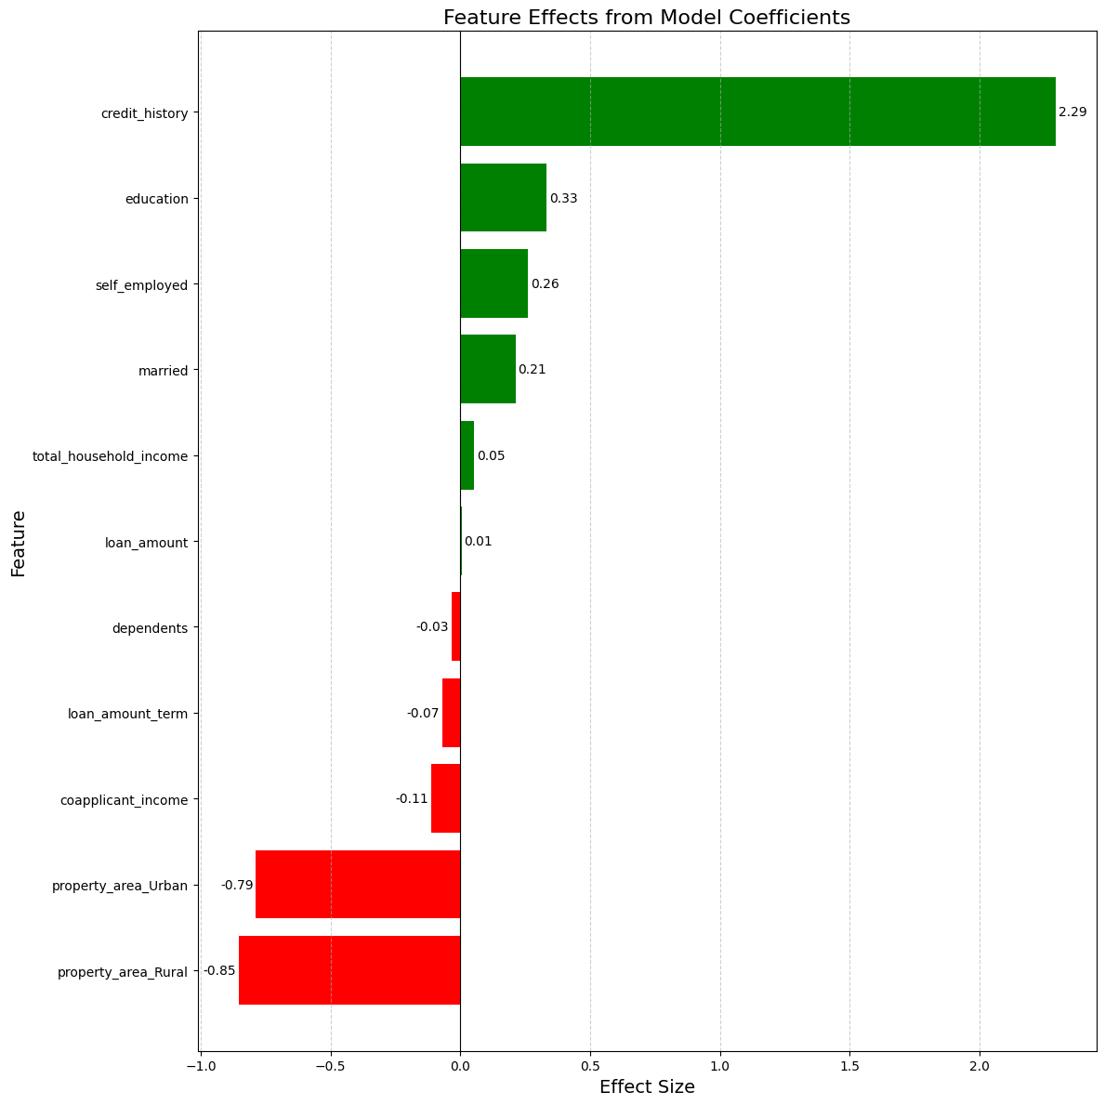
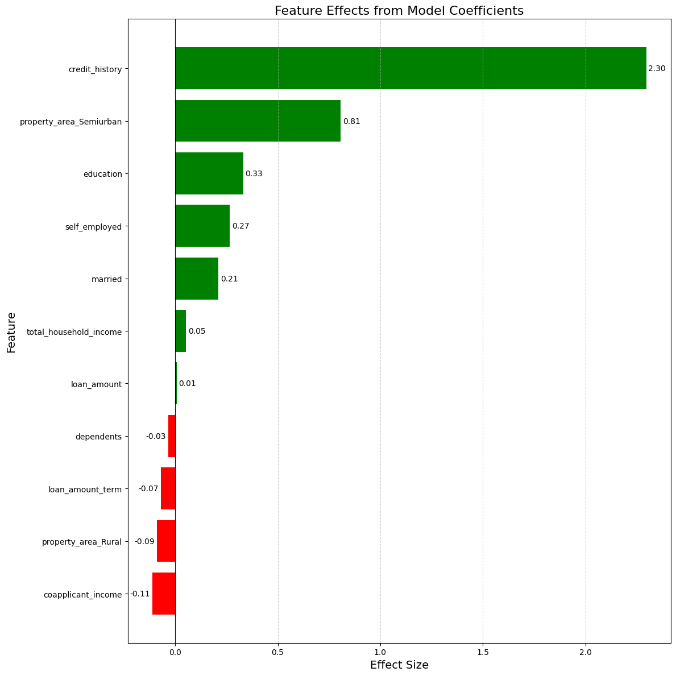
Model fitting and Evaluation
Semi-Urban (Reference)
Urban (Reference)

Slide 9
Final Thoughts
Model can be used to build an API to predict loan applications however with an accuracy score of 60% this is not recommended.
Credit History is the most influential factor when determining an applicant's likeliness of having their loan request accepted, followed by whether or not they reside in a semi-urban property.
Loan amount, loan term and applicant/co-applicant incomes were not important when considering an applicant's loan request.
GitHub Repo for this project available here: GitHub - LBHF-JamalFazaldin/MP-Proton-Bank-Model

Slide 10
Further Improvements
Including more records will enhance model accuracy specifically more records of individuals that have been accepted for a loan.
Instead of classifying credit history as good or bad a credit score maybe more useful.
Introducing more features such as age or asset wealth/collateral may enhance model performance.

